Slide 1


CAPSTONE PROJECT
flood Prediction Model
Presented By
Student Name: Harsh YADAV
College Name: Akhilesh Das Gupta Institute of professional studies (ggsipu)
Department: AI & ML
Email ID: HARSH2005.ADGITM@GMAIL.COM

Slide 2
OUTLINE:
Problem Statement
Proposed System/Solution
System Development Approach
Algorithm & Deployment
Result
Conclusion
Future Scope
References

Slide 3
Problem Statement:
Floods are among the most devastating natural disasters in India, causing loss of lives, destruction of property, and significant economic damage every year. Accurate and early flood prediction is critical to help authorities and communities take preventive measures and minimize disaster impacts.
This project aims to build a machine learning model that predicts the likelihood of flooding in a given area using three key environmental factors:
🌊 River Water Level (m)
🌧️ Rainfall (mm)
🌱 Soil Moisture (%)

Slide 4
Proposed Solution:
The proposed solution involves the following steps:
1. Data Collection & Preprocessing
  A dataset was prepared containing important features such as rainfall, river water levels, and soil moisture.
  The dataset was cleaned by handling missing values and removing inconsistencies.
2. Model Development
  A Decision Tree Classifier was implemented using scikit-learn to classify whether a flood would occur (Yes = 1, No = 0).
  The dataset was divided into training and testing sets to evaluate model performance.
3. User Interaction
  The model accepts user input values (rainfall, river level, and soil moisture) and predicts the likelihood of a flood.
  This makes the system interactive and usable in real-world applications.
4. Results & Evaluation
  The model achieved an accuracy of 74%, showing that machine learning can effectively predict flood risk with the given features.

Slide 5
System Approach:
1. Problem Identification
Floods are a recurring natural disaster in India, often causing loss of life, property, and agricultural damage.
The goal of this project is to build a machine learning-based model that can predict the possibility of a flood based on key environmental factors.
2. Data Collection
A dataset was created containing rainfall, river water level, and soil moisture values from Kaggle.
3. Data Preprocessing
The dataset was explored using .info(), .describe(), and .isnull().sum() to check for missing and inconsistent values.
Missing values were handled by cleaning or removing rows with incomplete data.
The dataset was then normalized and prepared for model training.
4. Model Development
The features (Rainfall, River_Level, Soil_Moisture) were selected as independent variables, and Flood (Yes/No) was chosen as the target variable.
5. Model Evaluation
The model was evaluated using accuracy score on the testing set.
6. User Interaction
The model was extended to take user inputs for rainfall, river level, and soil moisture.
Predictions are displayed interactively, showing whether a flood is likely to occur or not in the deployed state.

Slide 6
Algorithm & Deployment:
1. Understand Flood Prediction Concepts
Learn how environmental factors like rainfall, river level, and soil moisture contribute to floods.
Recognize the importance of early prediction in disaster management and community safety.
2. Data Handling Skills
Gain experience in importing, cleaning, and preprocessing datasets using pandas and numpy.
Learn to identify and manage missing values, outliers, and imbalanced data.
3. Exploratory Data Analysis (EDA)
Perform data visualization using matplotlib and seaborn to uncover trends and patterns.
Use statistical summaries (.info(), .describe(), .isnull().sum()) to understand dataset quality.
4. Machine Learning Model Development
Train and test a Decision Tree Classifier to predict flood occurrence.
Understand the workflow of splitting data into training and testing sets.
Learn how to measure performance using accuracy score.
5. Practical Application
Built interactive model that accepts user inputs (rainfall, river level, soil moisture) and predict flood.

Slide 7
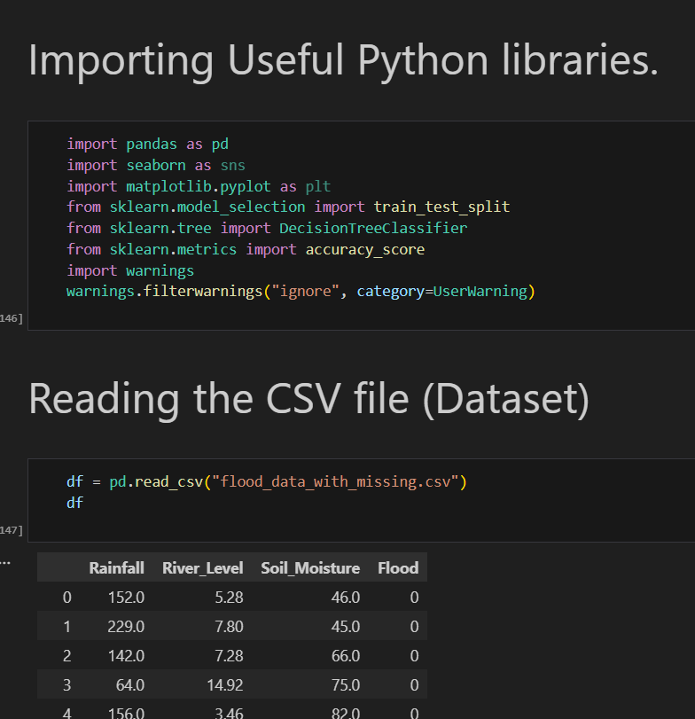
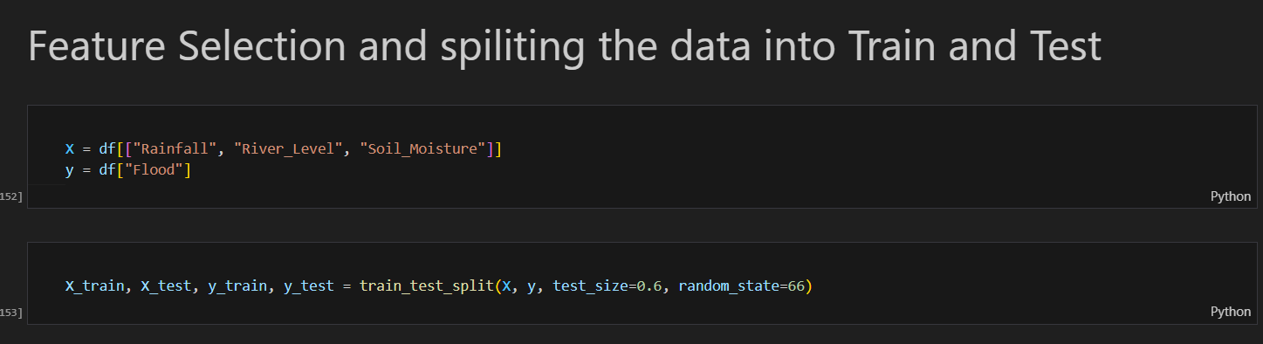
Result:

Slide 8
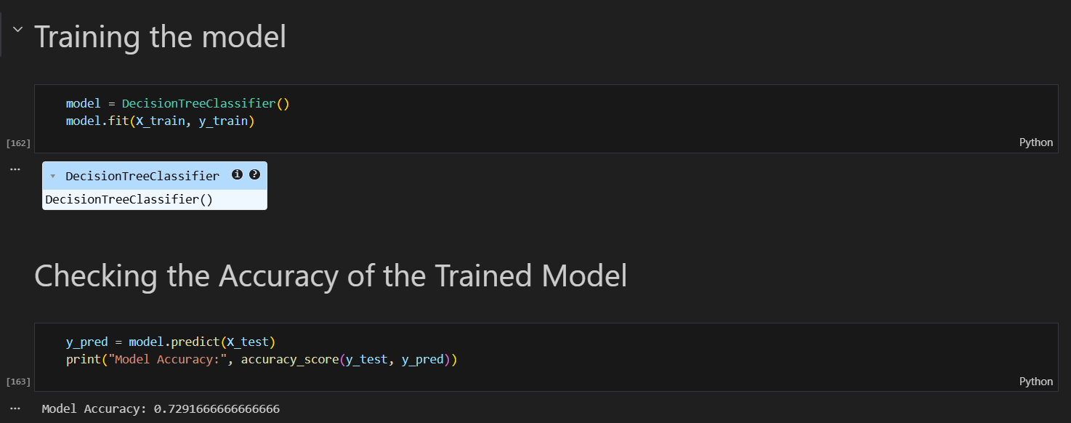

Slide 9
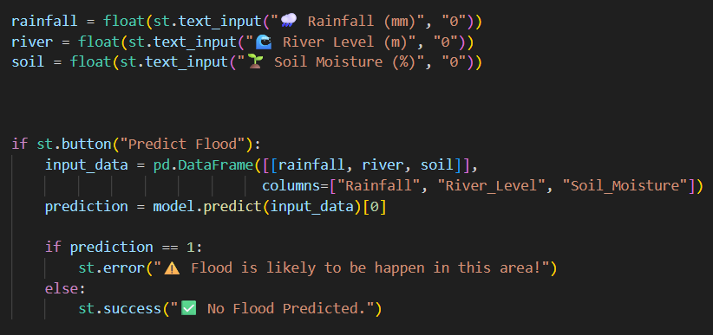

Slide 10
Conclusion:
This project successfully demonstrates the use of Machine Learning in predicting floods based on key environmental factors such as rainfall, river water level, and soil moisture. By applying a Decision Tree Classifier, the model was able to achieve an accuracy of approximately 68%, showing promising results in identifying potential flood risks.
Through data preprocessing, exploratory data analysis, and model evaluation, the project highlights how data-driven approaches can support disaster management systems. The model’s ability to accept user inputs and provide real-time predictions makes it practical and easy to implement in early warning frameworks.
In conclusion, this project demonstrates that artificial intelligence can be a valuable tool in mitigating the impact of natural disasters. By predicting floods with reasonable accuracy, it can assist governments, farmers, and local communities in making informed decisions, ultimately contributing to safety, preparedness, and sustainable development.

Slide 11
Future scope:
1. Time-Based Predictions
Shift from "will it flood?" to "when will it flood?"
Predict flood intensity (low/moderate/severe)
Forecast lead time (flood in 6hrs/12hrs/24hrs)
Implement LSTM/GRU for time series forecasting
2. Location Expansion
Scale from one area to multiple cities/states
Compare flood patterns across different regions
Build India-wide flood risk map
Transfer learning for data-scarce regions
3. Real-Time Deployment
Build mobile app/website for live alerts
Connect to live weather APIs
SMS/Whatsapp alert system for villagers
IoT sensor integration for real-time monitoring

Slide 12
References:
Kaggle – Drought Prediction Dataset
Retrieved from: https://www.kaggle.com
AICTE Mentor Sessions & Tutorial Classes
Guidance and conceptual understanding of Machine Learning techniques.
Online Technical Articles & Research Papers
Various academic and educational resources referred to for drought analysis and model development.
Google Search
Used for additional implementation support and conceptual clarification.
GitHub Link:
https://github.com/Harsh2005adgitm/MICROSOFT_ELEVATE-PROJECT_FLOOD_PREDICTION_MODEL

Slide 13
Thank You

